Slide 1




Towards Network-level Efficiency for Cloud Storage Services
Vancouver
Zhenhua Li, Tsinghua University
Cheng Jin, University of Minnesota
Tianyin Xu, UCSD
Christo Wilson, Northeastern University
Yao Liu, Binghamton University
Linsong Cheng, Tsinghua University
Yunhao Liu, Tsinghua University
Yafei Dai, Peking University
Zhi-Li Zhang, University of Minnesota
lizhenhua1983@gmail.com
http://www.greenorbs.org/people/lzh/
Nov. 5th, 2014
Notes:
Good afternoon, everyone! The title of our paper is …
I’m the 1st author …

Slide 2
Outline
① Background & Motivation
② Problem & Metric
③ Dataset & Benchmark
④ Findings & Implications
■ Summary of Contribution
Notes:
This is an outline of our talk. (Wait a second)
First, let’s look at the background and motivation

Slide 3





Cloud Storage Services
$from$
$anywhere$
$on$
$any device$
$at$
$any time$
store
share

Slide 4








Massive Popularity
Over 100M users
10M users in its first two months
1B files per day
Over 200M users
…
Over 14 PB data
Notes:
In a few short years, these services have quickly gained massive popularity. For the three market giants, each of them has attracted over 100 million users.
Meanwhile, there are some other services that have special features and user groups.

Slide 5
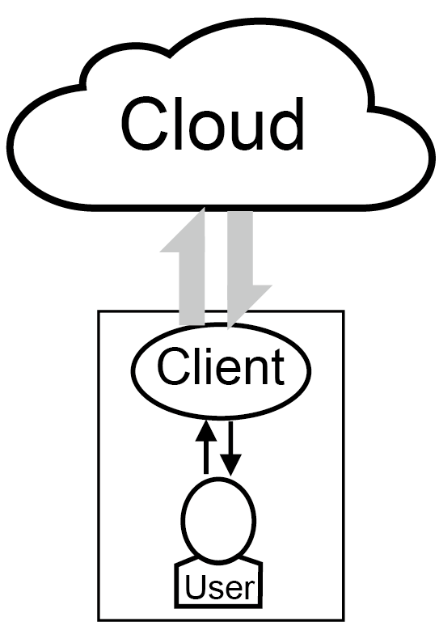








Key Operation
Index Content Notify
data
sync
data sync traffic
$$data sync event$$
$$file operation$$
Tremendous !
Create Delete Modify
Notes:
Designing and deploying a real-world cloud storage service involves a number of complicated issues, but the key operation is the data synchronization, which automatically maps user’s file operations onto the cloud via a series of data sync events.
The data sync events are used for transferring the data index, data content, sync notification, and so forth.
Naturally, …

Slide 6

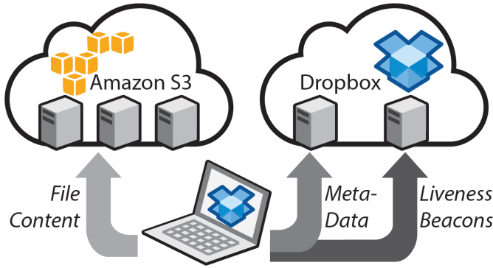
How Tremendous for a Provider?
[IMC’12] Drago et al : Large-scale Measurement of Dropbox
Over 100M users
Sync traffic ≈ 1/3 of traffic
Sync traffic of one file operation
= 5.18MB out + 2.8MB in
1B files per day
Monetary Cost of Dropbox sync traffic in one day ≈
$0.05/GB × 1 Billion × 5.18MB
= $260,000
* We assume there is no special pricing contract between Dropbox and Amazon S3, so our calculation of the traffic costs may involve potential overestimation.
Notes:
Specifically, we wonder …
Besides, the average sync traffic of one file operation is composed of …
Because Dropbox stores all the file contents in Amazon S3 and Amazon S3 only charges those outbound traffic, we …

Slide 7



How Tremendous for End Users?
Traffic-capped
(Mobile) Users
Bandwidth-constrained
Users
“ Keep a close eye on your data usage if you have a mobile cloud storage app! ”
“ Dirty Secret ”: Tremendous sync traffic almost saturates the slow-speed network link!
Notes:
On the other side, … In particular, we observe two types of users are suffering the most from tremendous sync traffic.

Slide 8





Success and Pains
$$financial$$
$$pains$$
$$technical$$
$$pains$$
Notes:
So in a nutshell, although …

Slide 9
② Problem & Metric
Notes:
Driven by this motivation, we raise a novel problem and propose a novel metric.

Slide 10
Fundamental Problem
Is the current data sync traffic of cloud storage services efficiently used?
Is the tremendous data sync traffic basically necessary or unnecessary?
Further broaden today’s broadband network
Enhance network-level design of today’s services
Notes:
Here the fundamental problem is …

Slide 11



A Novel Metric
To quantify the efficiency of data sync traffic usage of cloud storage services.
Power Usage Efficiency
$$PUE= \frac{Total facility power}{IT equipment power}$$
Traffic Usage Efficiency
$$TUE= \frac{Total data sync traffic}{Data update size}$$
Notes:
To address this problem in a scientific manner, first of all, we need a metric (Invoke Cartoon!)
In the cloud computing area, there is a widely used metric …
Borrowing a similar idea, we define the “traffic usage efficiency” of cloud storage services as …

Slide 12
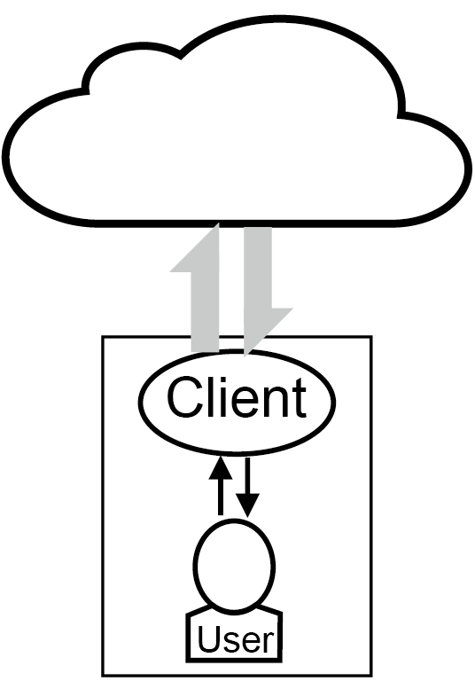
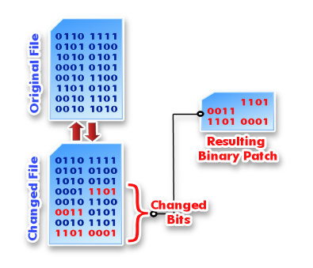
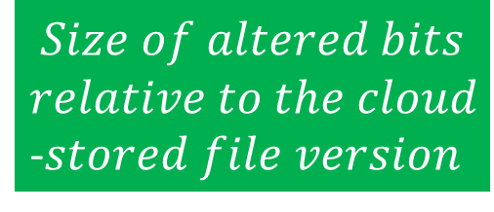
Data Update Size
$$Size of altered bits$$
$$relative to the cloud$$
-$stored file version$
User’s intuitive perception about how much traffic should be consumed
Compared with absolute value of sync traffic, TUE better reveals the essential traffic harnessing capability of cloud storage services
* If data compression is utilized, the data update size denotes the compressed size of altered bits.
Notes:
So what about the “data update size”?
When a user updates a file, the data update size is defined as …
We use this definition for two reasons:

Slide 13
③ Dataset & Benchmark
Notes:
In order to get a deep and comprehensive understanding of TUE, we collect a cloud storage dataset and conduct various benchmark experiments.

Slide 14

Dataset
A real-world user trace of six popular cloud storage services
$$practical$$
$$understanding$$
$$of the workload$$
$$characteristics$$
Over 150 long-term users in US and China
Over 222,000 files inside their sync folders
File attributes recorded in our collected trace
User name | File name MD5 | Original file size | Compressed file size
Creation time | Last modification time |  | Full-file MD5
Block-level MD5 hash codes (128 KB, 256 KB, ……, 8 MB, 16 MB)
☞ Available at http://www.greenorbs.org/people/lzh/public/traces.zip
Notes:
This table lists the detailed file attributes recorded in our dataset.
We have released the whole dataset in this public link.

Slide 15



Benchmark Experiments
$$in\text{−} depth$$
$$understanding$$
$$of the key$$
$$impact factors$$
Minneapolis
Beijing
Various Hardware
Powerful PC
Common PC
Outdated PC
Android Phone
Various Access Methods
PC client
Web browser
Mobile App
Various File Operations
Create, Delete
(Frequent) Modify
Compressed and Uncompressed
Notes:
Our benchmark experiments utilize three kinds of setups.
To guarantee the completeness of experiments, we have used …
With the comprehensive benchmarks, we can get an in-depth …

Slide 16
④ Findings & Implications
Notes:
With all the above efforts, we are able to unveil 6 findings and 6 implications.

Slide 17

File Creation - finding
1
The majority (77%) of files in our collected trace are small in size, which may result in poor TUE. Meanwhile, nearly two thirds (66%) of small files can be logically combined into large files.
< 100 KB
> 1 MB
Notes:
Our 1st finding is about file creation, that is, …

Slide 18

File Creation - implication
Small files should be properly combined into larger files for batched data sync (BDS) to reduce sync traffic. However, only Dropbox and Ubuntu One have partially implemented BDS so far.
1
What if we create one hundred 1-KB files in a batch?
Notes:
Obviously, …
For example, what if …
The ideal sync traffic should be nearly 100 KB, but the reality is …

Slide 19
File Modification - finding
2
84% of files are modified by users at least once. Most cloud storage services employ full-file sync, while Dropbox and SugarSync utilize incremental data sync (IDS) to save traffic for PC clients.
What if we modify 1 byte in a 1-MB file?
1.1 MB
50 KB
No IDS at all !

Slide 20


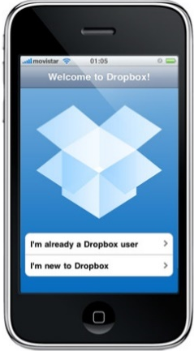
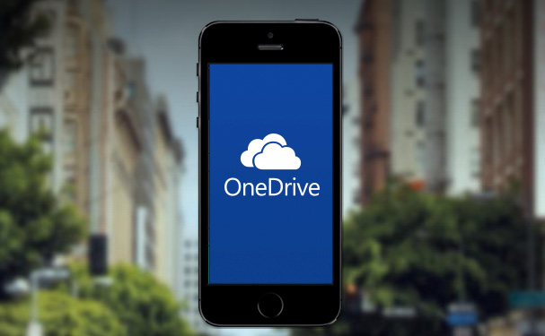
Why Not IDS for Web & Mobile?
IDS is hard to implement in a script language, particularly JavaScript
Unable to directly invoke file-level system calls/APIs like open, close, read, write, stat, rsync, and gzip.
Instead, JavaScript can only access users’ local files in an indirect and constrained manner.
(Probably) Energy concerns for IDS is usually computation intensive
Notes:
Here comes a question: …

Slide 21



Why Not IDS for most PC clients?
Conflicts between IDS and RESTful infrastructures
MODIFY = Local Modify +
PUT + DELETE
Typically only support data access operations at the full-file level,
like PUT, GET and DELETE.
Notes:
The other question is …
As a result, for both OneDrive and Ubuntu One, a MODIFY operation must be transformed to at least three operations: …

Slide 22
File Modification - implication
Also RESTful
Extra mid-layer to enable IDS
For a cloud storage service built on top of RESTful infrastructure, enabling IDS requires an extra, (maybe) complicated mid-layer. Given that file modifications frequently happen, implementing such a mid-layer is worthwhile.
2
Notes:
On the other hand, Amazon S3 is also RESTful, but why is Dropbox good at IDS? Our measurement reveals that …

Slide 23

File Compression - finding
$$\frac{Compressed file size}{Original file size}<90\%$$
3
52% of files can be effectively compressed. However, Google Drive, OneDrive, Box, and SugarSync never compress data, while Dropbox is the only one that compresses data for every access method.
What if we create a 10-MB text file?
Notes:
Here the word “effectively” means at least 10% of the file size can be reduced.

Slide 24


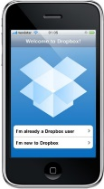

File Compression - implication
High-level compression, and cloud-side compression level seems higher
No user-side compression, while high-level cloud-side compression
Low-level user-side compression due to energy concerns of smartphones
For providers, data compression is able to reduce 24% of the total sync traffic.
For users, PC clients are more likely to support compression.
3
Notes:
More in detail, PC client performs … , …
But the web browser never compress data, …
Mobile apps only perform low-level …
Thus, our 3rd implication is summarized as …

Slide 25
File Deduplication - finding
4
Although we observe that 18% of user files can be deduplicated, most cloud storage services do not support data deduplication.
For security concerns
Web browsers never dedup data
Notes:
Our 4th finding is about …
In this table, only Dropbox and Ubuntu One deduplicate data for PC client and mobile app. Dropbox does not perform cross-user deduplication for security concerns. On the other hand, web browsers never dedup data.
Since Dropbox uses a block-level dedup while Ubuntu One uses a full-file dedup, we want to know (Next Page)

Slide 26
Full-file vs. Block-level Dedup
* We are dividing files to blocks in a simple and natural way, i.e., by starting from the head of a file with a fixed block size. So clearly, we are not dividing files to blocks in the best possible manner which is much more complicated and computation intensive.
Block-level dedup exhibits trivial superiority to full-file dedup, but is much more complex
4
We suggest providers just implement full-file deduplication since it is both simple and efficient.
Notes:
the superiority of block-level dedup compared with full-file dedup.
Through trace-driven simulations, we indicate that …
Therefore, we suggest …

Slide 27

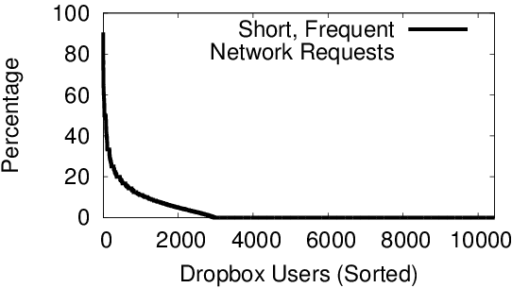
Frequent modifications - finding
Frequent, short data updates
time
Session maintenance traffic far exceeds real data update size
Network traffic for data synchronization
The Traffic Overuse Problem
Zhenhua Li et al.
Efficient Batched Sync in Dropbox-like Cloud Storage Services. In Proc. of ACM Middleware, 2013.
For 8.5% Dropbox users, >10% of their traffic is generated in response to frequent modifications
Notes:
Our 5th finding is about a special kind of file operations, that is, frequent modifications where the session maintenance traffic far exceeds the real data update size.
And this behavior is referred to as …
Measurements illustrate that

Slide 28
Sync Deferment
What if we append X KB per X sec until 1 MB ?
5
1) Frequent modifications to a file often lead to large TUE.
2) Some services deal with this issue by batching file updates using a fixed sync deferment. However, fixed sync deferments are limited in applicable scenarios.
Notes:
To investigate the TUE of frequent modifications, we …
From the six figures, we get two findings. First, …
… but when the appending period exceeds 4 seconds, the TUE suddenly jumps to 250!

Slide 29



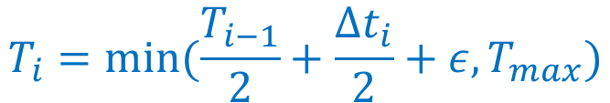
Frequent modifications - implication
To fix the problem of fixed sync deferment, we propose an adaptive sync defer (ASD) mechanism that dynamically adjusts the sync deferment.
5
$T_{GoogleDrive}≈$ 4.2 sec
Sync
Deferment
$$T_{i}=min⁡(\frac{T_{i−1}}{2}+\frac{{∆t}_{i}}{2}+ε,T_{max})$$
$T_{OneDrive}≈10$.5 sec
$T_{SugarSync}≈$6 sec
Notes:
To fix the problem …
Specifically, when a series of frequent data updates arrive, the sync deferment of Google Drive, … is fixed to … , respectively. So each deferment is limited in applicable scenarios.
On the contrary, by using a simple adaptive function, ASD can well handle the problem.

Slide 30
Network & Hardware Impact
Network and hardware do not affect the TUE of simple file operations, but significantly affect the TUE of frequent modifications
30
Notes:
Our last finding is about the impact of network and hardware. Summarizing the experiment results, …

Slide 31
Network & Hardware – finding and implication
6
Surprisingly, we observe that users with relatively low bandwidth, high latency, or slow hardware save on sync traffic, because their file updates are naturally batched together.
In the case of frequent file modifications, today’s cloud storage services actually bring good news (in terms of TUE) to those users with relatively poor hardware or Internet access.
6
Notes:
From the five figures, …
As a result, …

Slide 32

■ Summary of Contribution
Problem: Is the current data sync traffic of cloud storage services efficiently used?
Metric: Traffic Usage Efficiency
$$TUE= \frac{Total data sync traffic}{Data update size}$$
6
Findings
A considerable portion of the data sync traffic is in a sense wasteful
6
The wasted (tremendous) traffic can be effectively avoided or significantly reduced via carefully designed sync mechanisms
Implications
Notes:
Finally, the summary of our contribution.
First, we raise a simple yet critical problem: …
To address the problem in a quantitative manner, we propose …
Through both … , we have 6 findings which illustrate that …
And we provide 6 implications which confirm that …

Slide 33

The End
Thank you!
Notes:
So this is the end of our talk, thank you for your attention!

Slide 34
Press ESC to exit …

Slide 35
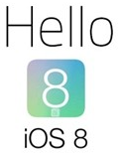

The Case of iCloud Drive
Released in Oct. 2014 with
Efficient BDS (batched data sync) for OS X, but not for web browser or iOS 8
IDS (incremental data sync) for OS X, but not for web browser or iOS 8
No compression at all
Fine-grained (KBs) level dedup for OS X, but not for web browser or iOS 8
Quite unstable at the moment

Slide 36
Limitation of Our Research
Black-box measurement are insufficient
What happens after the data packet dives into the cloud?
“Google Drive, OneDrive, and Dropbox do have traffic problems. But have you considered the problems from a system design/tradeoff perspective?”
Traffic
Storage
Computation
Operation
We expect measurement work from a system insider’s perspective!

Slide 37
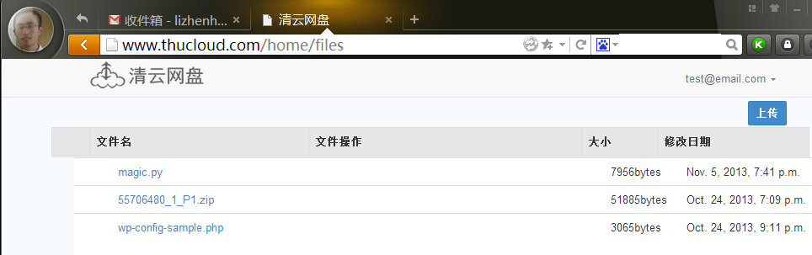


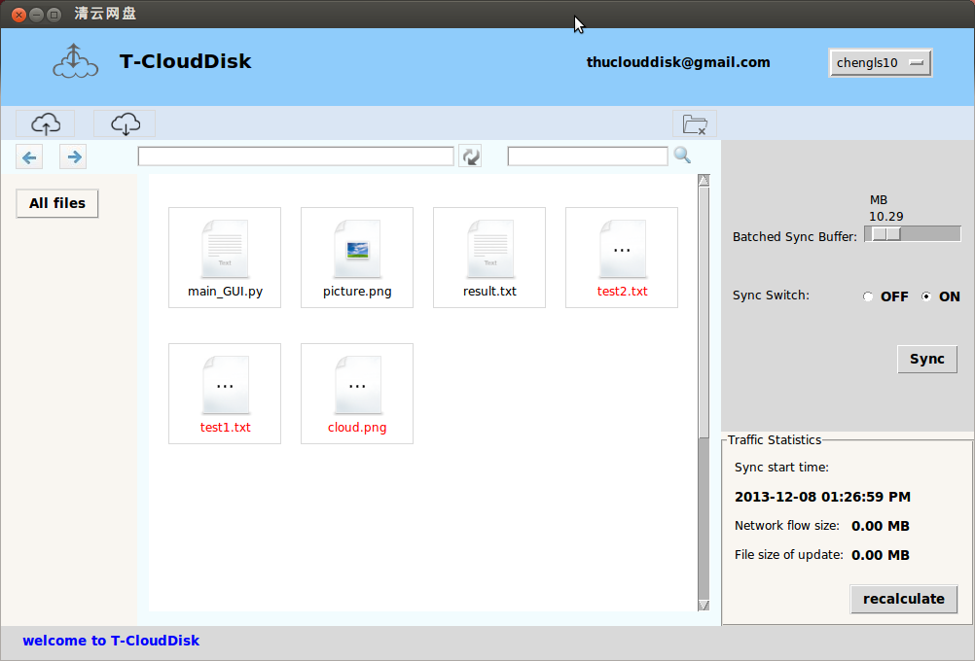



http://www.thucloud.com

Slide 38
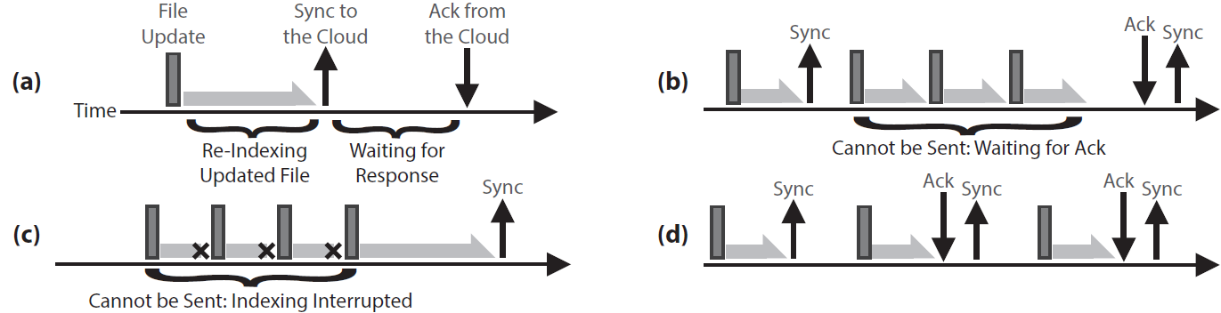
Working Principle of Dropbox Client
The four basic components of Dropbox client behavior
First, Dropbox client must re-index the updated file --- computation intensive
A file is considered “synchronized” to the cloud only when the cloud returns ACK
This is why some data updates are “batched” for synchronization unintentionllay
Sometimes, when data updates happen even faster than the file re-indexing speed, they are also “batched” for synchronization

Slide 39
Design Framework
—— from the perspective of TUE
Notes:
In order to get a deep and comprehensive understanding of TUE, we must have some knowledge about the design framework of cloud storage services, in particular from the perspective of TUE.

Slide 40
Impact Factors vs. Design Choices
Objective
Subjective
Compression
Level *
Metadata
structure
File
replication
Sync granularity
Dedup granularity
Server
location
Network
Bandwidth
RTT
Sync
traffic
Sync
delay
Client
Location
Client
Hardware
Access
Method
File
size
File
operation
Update
size
Update
rate
……
Compression
Level
Sync
deferment
Notes:
A real-world cloud storage service involves a lot of issues, locating on the cloud side, …

Slide 41
Selecting Rules
Compression
Level *
* The server-side data compression level may be different from the client-side
Metadata
structure
File
replication
Rule 1: The impact factors should be relatively constant or stable, so that the research results can be easily repeated.
Sync granularity
Dedup granularity
Server
location
Bandwidth
RTT
Sync
traffic
Sync
delay
Rule 2: The design choices should be measurable and service/implementation independent, so as to make the methodology widely applicable.
Client
Location
Client
Hardware
Access
Method
File
size
File
operation
Update
size
Update
rate
……
Compression
Level
Sync
deferment
Notes:
Facing so many issues, we have to select a few key issues for our study?
The first rule is

